Slide 1
Discrete Mathematics
South China University of Technology
1

Slide 2
Chapter 10. Trees
Tree Traversal
Section 10.3
2

Slide 3
Contents
1
Introduction
2
Traversal Algorithms
3
Infix, Prefix, and Postfix Notation
3

Slide 4
Introduction
4

Slide 5
Ordered rooted trees
Ordered rooted trees are often used to store information.
We need procedures for visiting each vertex of an ordered rooted tree to access data.
Ordered rooted trees can also be used to represent various types of expressions, such as arithmetic expressions involving number, variables, and operations.

Slide 6
Universal Address Systems
Procedures for traversing all vertices of an ordered rooted tree rely on the orderings of children.
In ordered rooted trees, the children of an internal vertex are shown from left to right in the drawings representing these directed graphs.
We do this recursively :
1. Label the root with integer 0. Then label its k children (at level 1) from left to right with 1, 2, 3, …, k.
2. For each vertex v at level n with label A, label its k children, as they are drawn from left to right, with A.1, A.2,…,A.k.

Slide 7
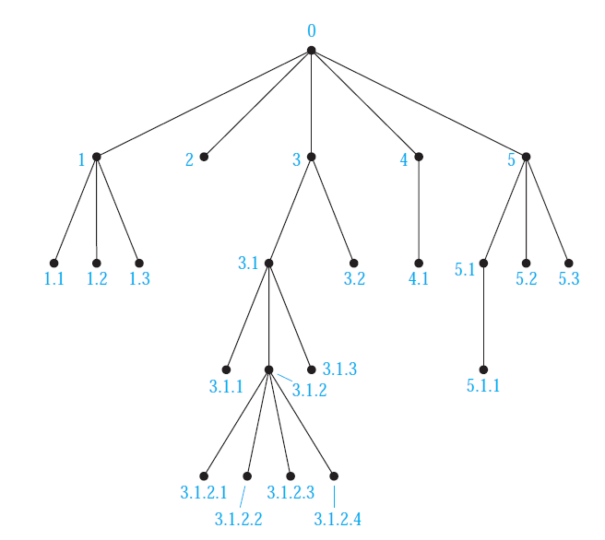

Slide 8
Traversal Algorithm
8

Slide 9
Traversal algorithms
Procedures for systematically visiting every vertex of an ordered rooted tree are called traversal algorithms.
Preorder traversal.
Inorder traversal.
Postorder traversal.

Slide 10
Preorder Traversal
Definition 1: Let T be an ordered rooted tree with root r.
If T consists only of r, then r is the preorder traversal of T.
Otherwise, suppose that T1,T2,…,Tn are the subtree at r from left to right in T.The preorder traversal begins by visiting r.

Slide 11
Preorder Traversal
It continues by traveling T1 in preorder, then T2 in preorder, then T2 in preorder, and so on, until Tn is traversed in preorder.
Step1: Visit r
T1
T2
Tn
……
Step2: Visit T1
Step3: Visit T2
Step n: Visit Tn

Slide 12
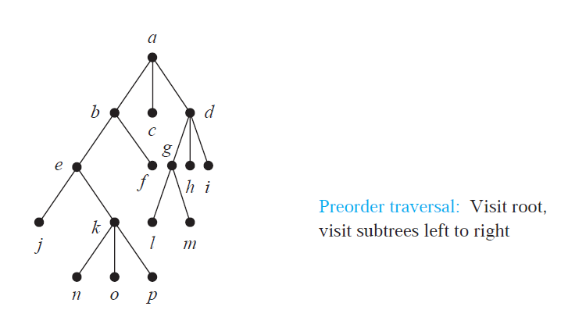

Slide 13
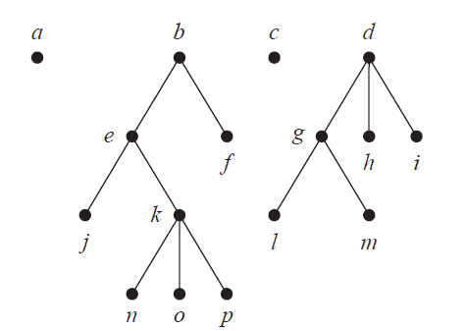

Slide 14
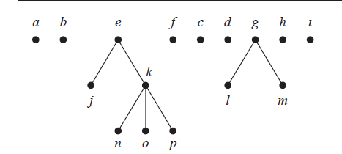

Slide 15
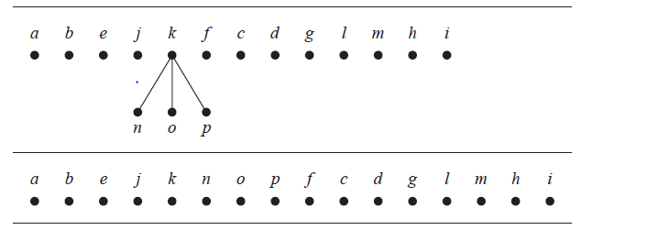

Slide 16
Algorithm 1: Preorder Traversal
Procedure preorder (T: ordered rooted tree)
r : = root of T
List r
For each child c of r from left to right
Begin
T(c) : = subtree with c as its root
preorder(T(c))
End

Slide 17
Inorder Traversal
Definition 2: Let T be an ordered rooted tree with root r.
If T consists only of r, then r is the inorder traversal of T.
Otherwise, suppose that T1,T2,…,Tn are the subtree at r from left to right.
The inorder traversal begins by traversing T1 inorder, then visiting r.
It continues by traversing T2 in inorder, then T3 in inorder,…, and finally Tn in inorder.

Slide 18
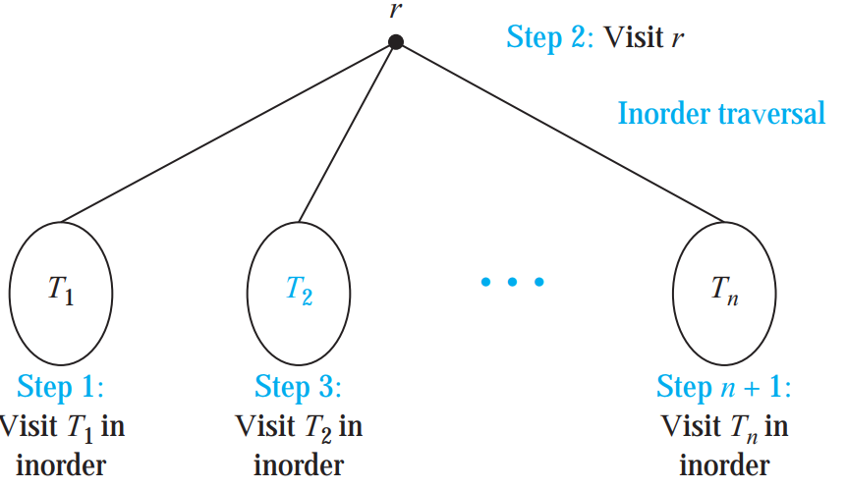
Inorder Traversal

Slide 19
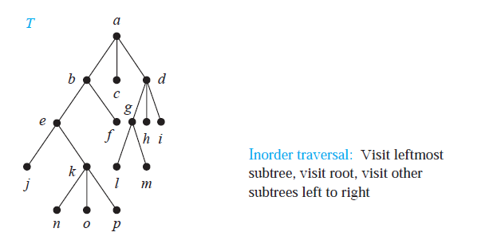

Slide 20
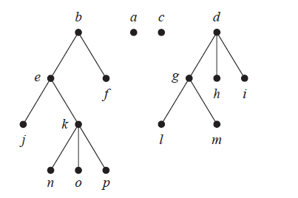

Slide 21
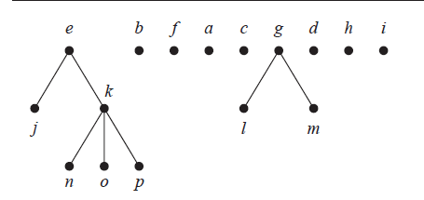

Slide 22
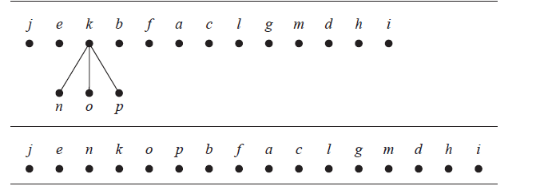

Slide 23
Algorithm 2: Inorder Traversal
Procedure inorder (T: ordered rooted tree)
r : = root of T
if r is a leaf then list r
Else Begin
l : = first child of r from left to right
T(l) : = subtree with l as its root
inorder(T(c))
list r
for each child c of r except for l from left to right
T(c) : = subtree with c as its root
inorder(T(c))
End

Slide 24
Postorder Traversal
Definition 3: Let T be an ordered rooted tree with root r.
If T consists only of r, then r is the postorder traversal of T.
Otherwise, suppose that T1,T2,…,Tn are the subtree at r from left to right.
The postorder traversal begins by traversing T1 postorder.
It continues by traversing T2 in postorder, then T3 in postorder,…, and finally Tn in postorder.

Slide 25
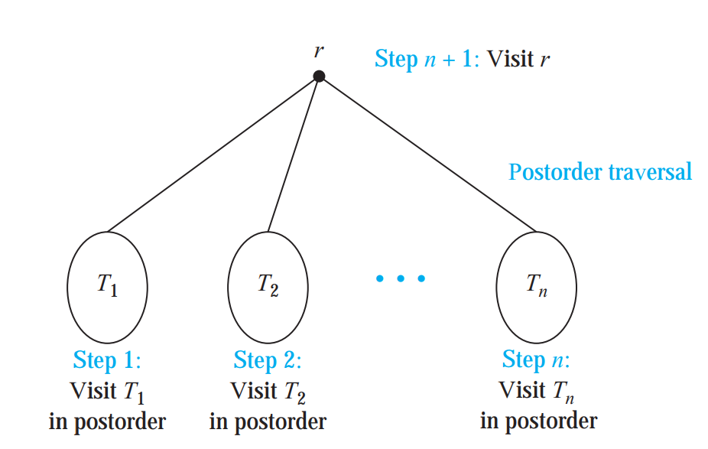
Postorder Traversal

Slide 26
Example 4
Does a postorder traversal visit the vertices in the ordered rooted tree T ?
j
n
o
a
p
b
c
d
k
e
e
f
f
g
h
i
b
c
k
l
m
l
j
m
g
h
i
n
o
p
d
a

Slide 27
Algorithm 1: Postorder Traversal
Procedure postorder (T: ordered rooted tree)
r : = root of T
For each child c of r from left to right
Begin
T(c) : = subtree with c as its root
postorder(T(c))
End
List r

Slide 28
Infix, Prefix, and Postfix Notation
28

Slide 29
Representation of expression
+ addition
- subtraction
* multiplication
/ division
↑ exponentiation
((x+y)↑2)+((x-4)/3)

Slide 30
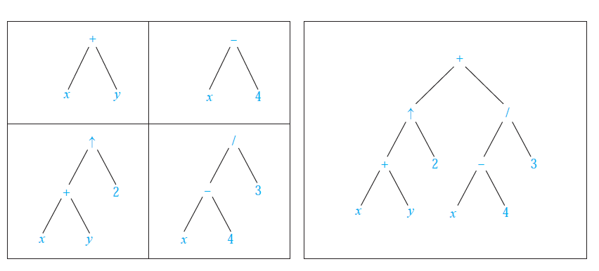
A Binary Tree Representing ((x+y)↑2)+((x-4)/3)

Slide 31
Infix form
To make such expressions unambiguous it is necessary to include parentheses in the inorder traversal whenever we encounter an operation.
The fully parenthesized expression obtained in this way is said to be in infix form.

Slide 32
Example 5
(x+y) / (x+3) (x+(y/x))+3 x+(y/(x+3))
+
+
/
+
3
x
/
+
+
x
/
y
+
x
y
x
3
y
x
x
3

Slide 33
Prefix form
We obtain the prefix form of an expression when we traverse its rooted tree in preorder.
Expression written in prefix from are said to be in Polish notation波兰记法, which is named after the Polish logician Jan Lukasiewicz.

Slide 34
Example 6
What is the prefix form for the expression ((x+y)↑2)+((x-4)/3) ?
Solution : + ↑+ x y 2 / - x 4 3
+
↑
/
-
+
2
3
x
y
x
4

Slide 35
how to compute + - * 2 3 5 / ↑2 3 4 ?
From right to left, performs operations using the operands on the right

Slide 36
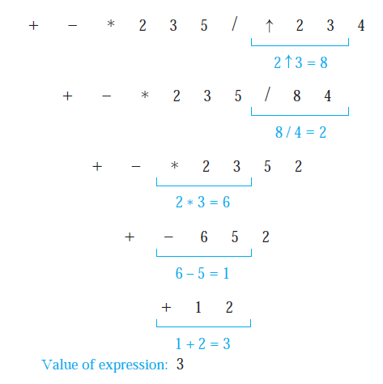

Slide 37
Postfix form
We obtain the postfix form of an expression by traversing its binary tree in postorder.
Expression written in postfix from are said to be in reserve Polish notation.
Expression in reserve Polish notation are unambiguous, so parentheses are not needed.

Slide 38
Example 8
What is the postfix form for the expression ((x+y)↑2)+((x-4)/3) ?
Solution : xy + 2 ↑ x 4 − 3 / +
+
↑
/
-
+
2
3
x
y
x
4

Slide 39
How to compute 7 2 3 * - 4 ↑9 3 / +?
Starts at the left and carries out operations when two operands are followed by an operator

Slide 40
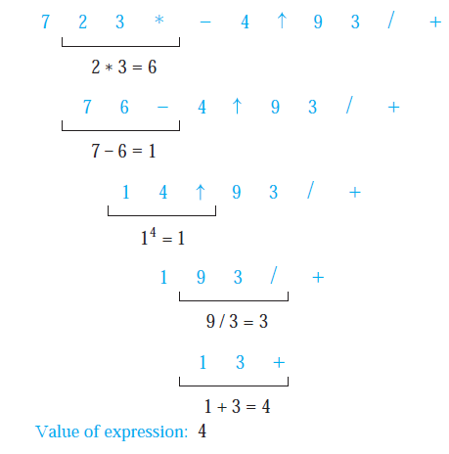

Slide 41
Example 10
Find the ordered rooted tree representing the compound proposition (¬(p ∧ q)) ↔ (¬p ∨ ¬ q) .
Then use this rooted tree to find the prefix, postfix, and infix forms of this expression.
↔
¬
∨
∧
¬
¬
p
q
p
q

Slide 42
对于一元运算符, 操作数作为他的左孩子还是右孩子?
在先序遍历和后续遍历中没有差别.
在中序遍历中有差别, 一般作为右孩子，因为操作数在运算符号在后面, 例如¬ P.

Slide 43
Example 10
↔
¬
∨
∧
¬
¬
p
q
p
q
Preorder : ↔ ¬ ∧ p q ∨ ¬ p ¬ q
Postorder: p q ∧ ¬ p ¬ q ¬ ∨ ↔
Inorder : (¬ (p ∧ q)) ↔ ((¬ p ) ∨ (¬ q ))

Slide 44
Infix, ambiguous
Prefix, unambiguous
Postfix unambiguous

Slide 45
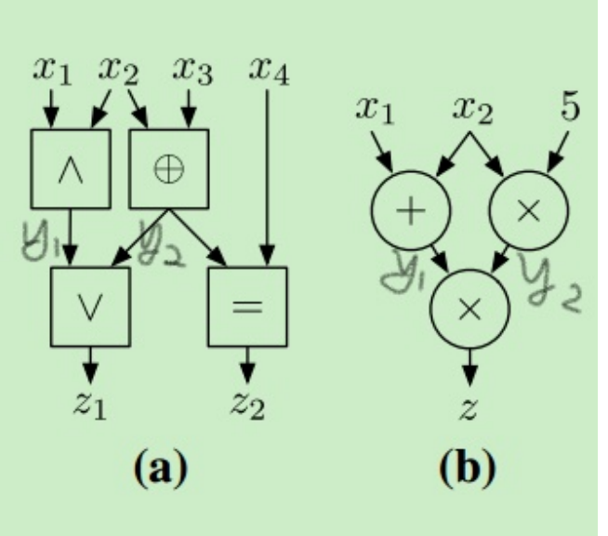
思考题
姚氏电路是一种隐私保护技术. 其中一个基础环节, 是软件模拟物理电路(见下图)的运算. 设C(x,y)=z是一块物理电路,其功能是: 输入xy, 输出z. 已知其电路图是G=(V,E). 请设计算法A(G,x,y) →z:
A的输入: G,x,y
A的输出: z
A的功能: z=C(x,y)

Slide 46
Homework
5,
9, c),d)
11.c)

Slide 47
End of Section 10.3
Click to edit company slogan .
47

